Slide 1


A Postgres Server for point clouds storage and processing
Presented at postgresl PARIS session 6.
https://github.com/Remi-C/Postgres_Day_2014_10_RemiC
Rémi Cura
Julien Perret – Nicolas paparoditis – GildaS Le meur

Slide 2
SUmmary
1. Introduction to Point clouds
2. Why use a DBMS?
3. PointCloud : Efficient storing/QUERYING/LOADING in postgRes
4. In base processing
5. using the point cloud server in complex architectures
A. references
B. Annexes (screens, details)

Slide 3
Warning
A fair warning :
Except PointCloud : the tools I present are research tools.
NOT for production, NOT reliable
All open source (here , here , here), including nice data set
efficient storing/querying/Loading in postgres Prototype
In base processing Proof of concept
Visu
LOD Proof of concept
Streaming Prototype
Complex architecture
Point cloud streaming Prototype
Interactive road side modeling Prototype
Batch computing Prototype

Slide 4
Introduction to Point clouds
What are point clouds
Order of magnitude

Slide 5
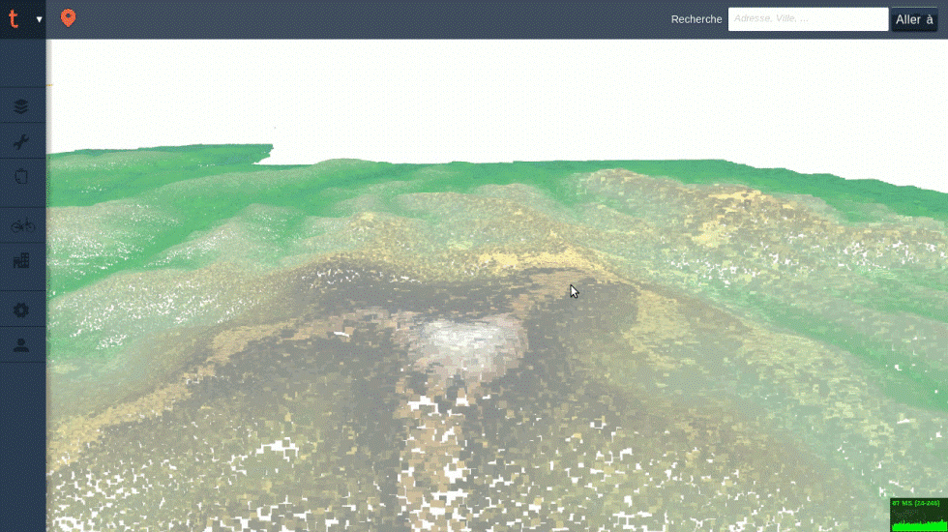
Introduction to Point clouds
Note: sexy point cloud images

Slide 6
Introduction to Point clouds
What are Point Clouds?
A set of unordered 3D points with attributes resulting from a sensing operation.
Unordered: don’t know who the neighbors are .
Attributes: ex: intensity of returning light, class id
Sensing: physical sensing of reality, not like a vector point representing the position of a tree (no semantic).
Mostly from :
Active sensors (laser time of flight based):
Terrestrial tripod
Terrestrial vehicle (cars/robot)
Aerial vehicle (plan/drone)
Passive/mixed : image (stereovision). RGBZ device (Kinect)

Slide 7
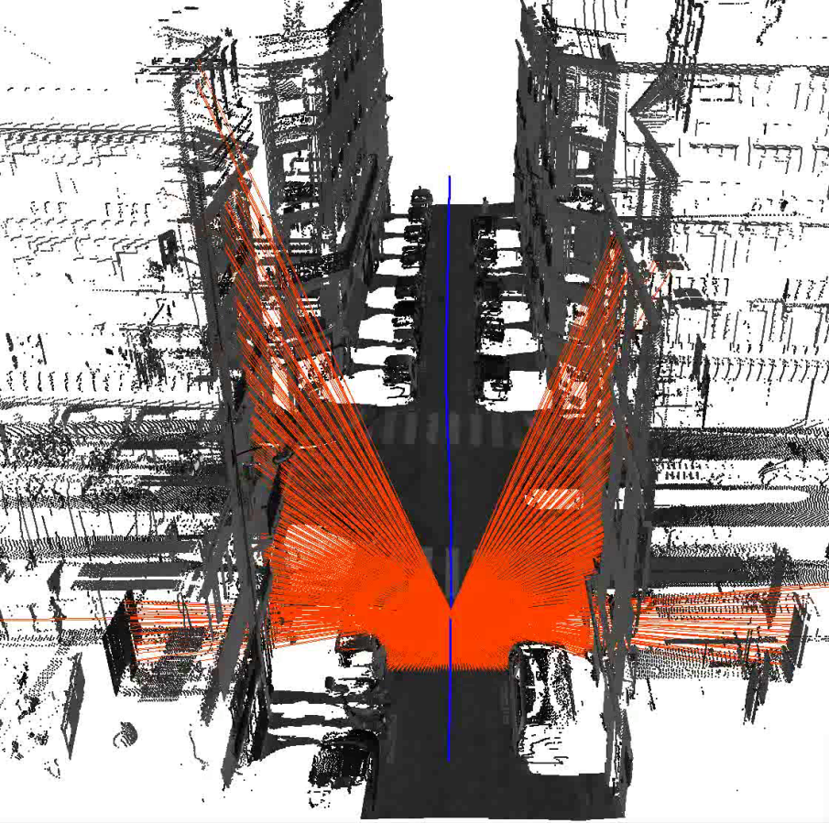
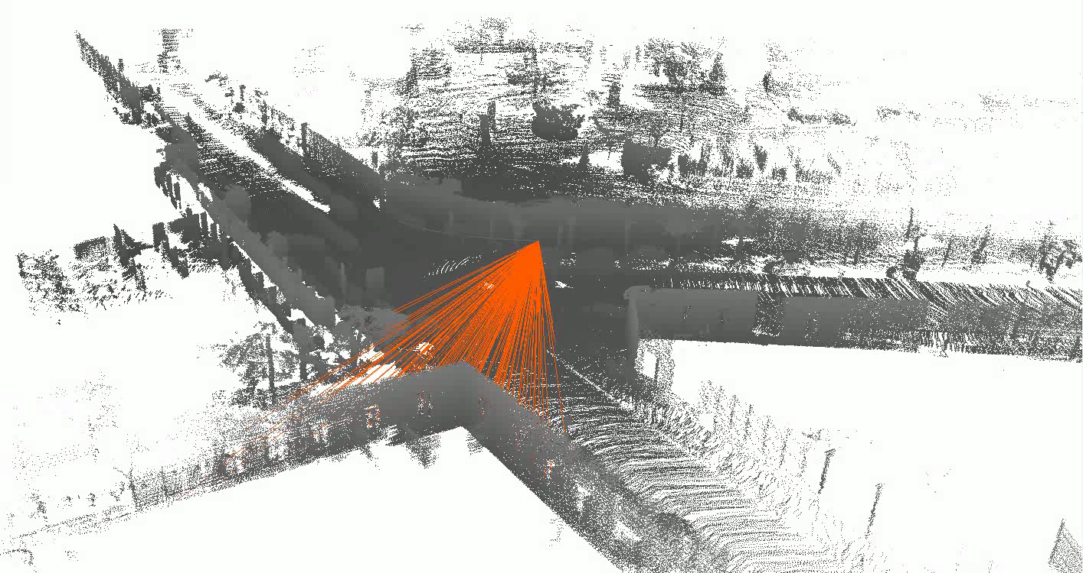
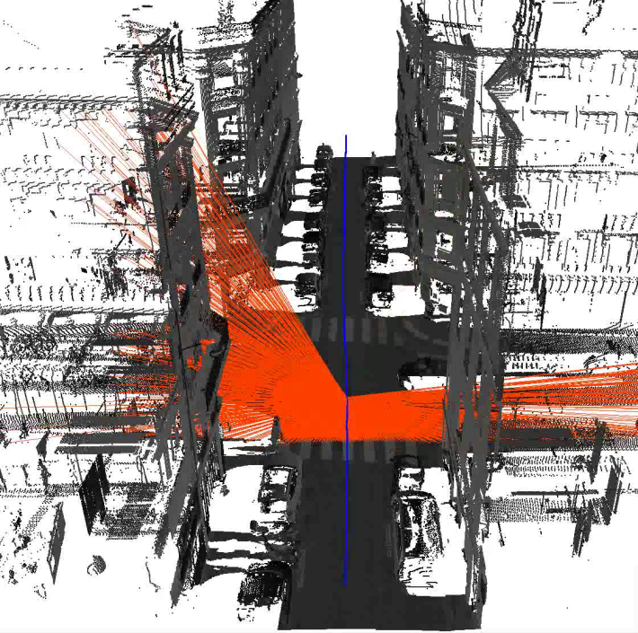
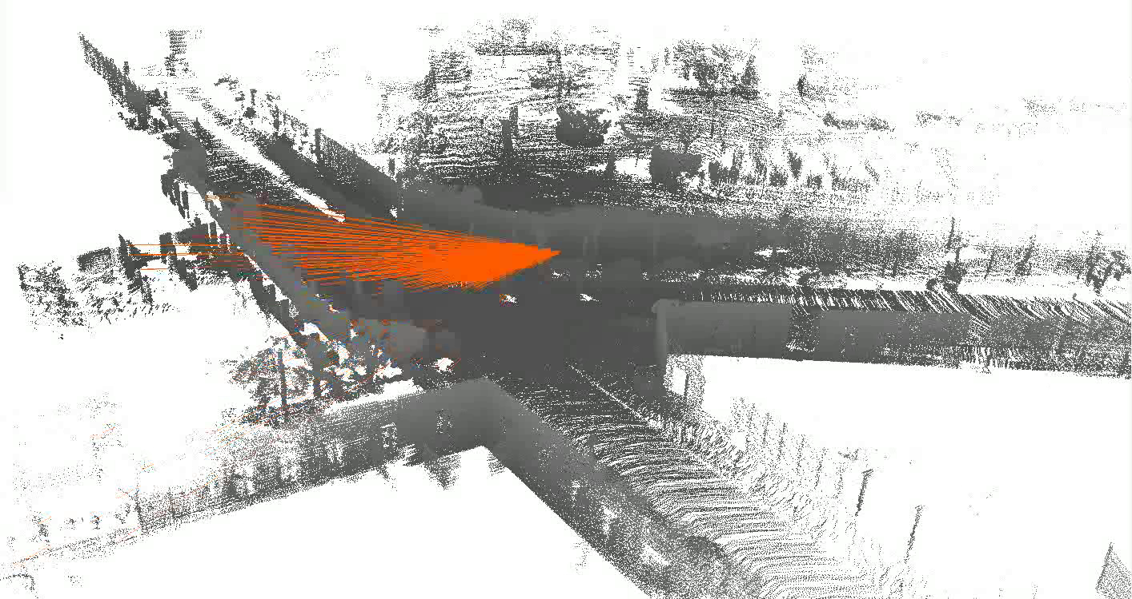
Introduction to Point clouds
Velodyn Laser
Riegl laser
Illustration : F. Monier, IGN

Slide 8
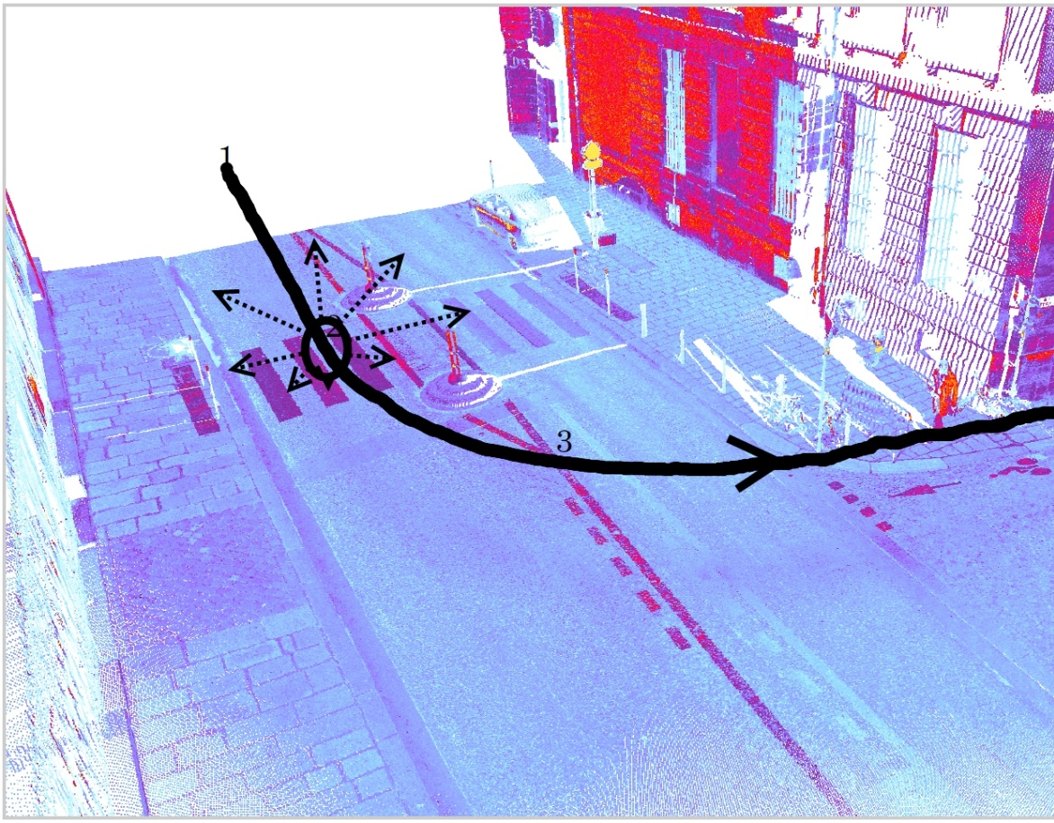
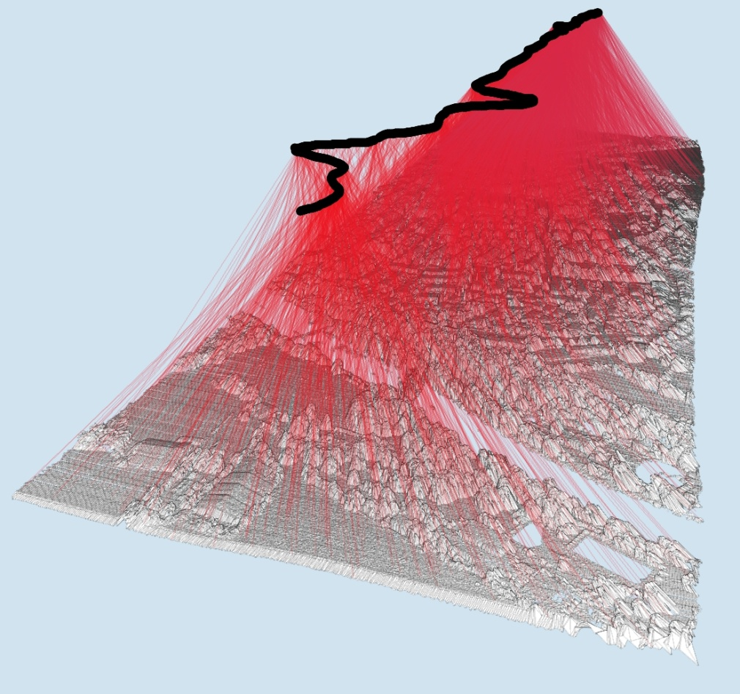
Introduction to Point clouds
Example : aerial and terrestrial point clouds
Non constant very high density
Almost constant low density
Image from J. Demantké Thesis, 2013
Image from J. Demantké Thesis, 2013

Slide 9
Introduction to Point clouds
Why so many people use it?
3D from images is an ill posed problem. (i.e.: given a pixel in image space, what is its position and size in real world )
Very good precision (close and long range)
Reliable
Devices are cheap-ish
Complements very well images.

Slide 10
Introduction to Point clouds
Point clouds are cool, but very BIG
Current devices: 1 Million points/sec, 12+ attributes. Outch !
1 hour: several Billions points.
French mapping agency: 100’s of data sets, aerial + terrestrial, several type of lasers.
Can’t load much more than 20 Millions points in memory => can’t process much more than 10 Millions points at a time.
So much data: personal copy of it is not an option. All data must be centralized on specific storage solution.

Slide 11
Why use a DBMS?
What people do with point clouds?
Using A File system solution
Using A DBMS solution

Slide 12
Why use a DBMS?
What people do with point clouds?
(See [3] in “ressources”)
Create data
Get data based on localization time attributes
Mix data set
Convert data
Process data
Visualize data
Update data

Slide 13

Why use a DBMS?
Illustration of quad tree in filesystem
Typically, point clouds are cut in pieces to form a hierarchy of folders (ex : quad tree).
Level folder cum_folder
Coverage
Folder
Folder
number
0 1 1
1 4 5
2 16 21
3 64 85
4 2.6e+02 3.4e+02
5 1e+03 1.4e+03
6 4.1e+03 5.5e+03
7 1.6e+04 2.2e+04
8 6.6e+04 8.7e+04
9 2.6e+05 3.5e+05
10 1e+06 1.4e+06
11 4.2e+06 5.6e+06
12 1.7e+07 2.2e+07
/s1
4⁰
/s1/s1..4
4¹
/s1/s1..4/s1..4
4²
Greater than max folder number on NTFS and EXT filesystem
Is it sufficient? 100k pts/file
8*10⁶ * 10⁵ = 10¹¹ = 800 Billions pts.
For one laser : 3.6 Billions/h.
Working day : 30 Billions
=> Only 30 days of work for 1 laser!

Slide 14
Why use a DBMS?
File system limitations
Create data
Get data based on localization time attributes
Mix data sets
Convert data
Process data
Visualize data
Update data
Only 1 user at a time
Need to choose a File structure adapted to one and only one query type
Very difficult
OK
User need to create manually buffers of points
OK
Only 1 user at a time

Slide 15
Why use a DBMS?
Using a file system
Everything can be done, but it would amount to redeveloping a DBMS system !
No security of the data
No concurrency
Need a different solution for every kind of geo-data (points, raster, vector)
Comparison to raster world: Who use pure file system solution for data over 100’s of To?

Slide 16
Why use a DBMS?
USing A DBMS solution
Allow concurrency / clusters of servers
All geospatial data in the same place
Efficient querying on localization & time & attributes & data set
Proper management of metadata at the data set level + relational link to other data.
Point clouds as a service : can be integrated in sophisticated client system.
Why use Postgres and not a NoSQL database?
Parallel computing on multi cluster possible (postgres-xc)
Full ACID warranty
Can use python/R/C/Java
All geo data in same place.

Slide 17
PointCloud : efficient storing/querying/Loading in postgres
Storing point clouds in DBMS : 2 approaches
What is PointCloud?
Efficient storage
FAST querying
FAST loading
Order of magnitude

Slide 18
efficient storing/querying/Loading in postgres
Storing point clouds in DBMS : 2 approaches
1 point =
GPS_time (s) X (m) Y(m) Z(m) reflectance (…. )
54160.295 2068.230 20690.025 45.934 -9.4497
1 row = 1 point
Analogy : ST_Point
1 row = N points
Analogy : ST_MultiPoint
Billions of row -> manual partitioning
Billions of row -> big indexes
Double/float storage -> wasted storage
1 row = 1 point -> no compression
Different laser -> no compatibility
Different laser -> custom code everywhere
Millions of row -> 1 table per dataset
Millions of row -> small indexes
Custom bit width -> efficient storage
1 row = N point -> compress by redundancy
Different laser -> 1 family type
Different laser -> postgres extension
Usage : do we really need to get points 1 by 1?

Slide 19
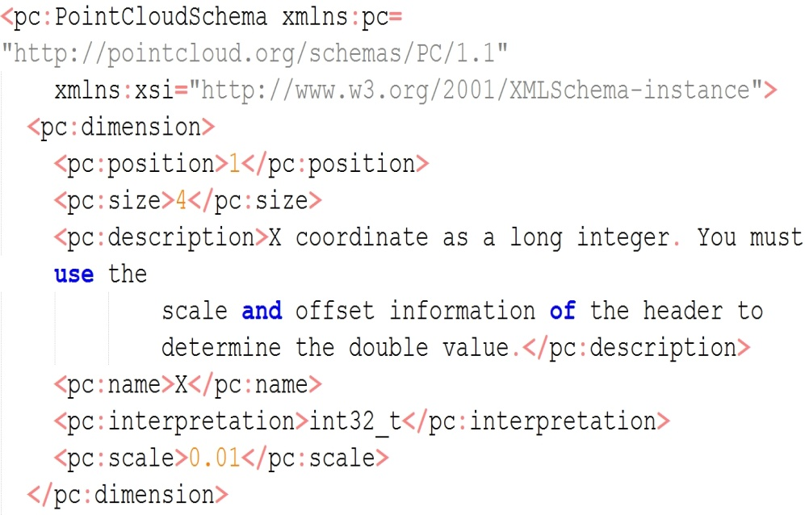
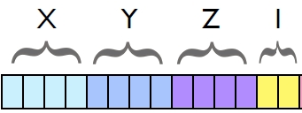
efficient storing/querying/Loading in postgres
What is PointCloud?
A Postgres extension created by P.Ramsey (founder of PostGis) (see ref.).
Strong similarities to PostGIS (design, robustness, reliability, perfs) !
New types (PC_Point, PC_Patch) + cast to geom + functions
PC_PATCH(schema)
XML Schema
BBOX (PostGIS geometry)
Metadata , stats
PC_POINT(schema)
Illustration
from [2]

Slide 20
efficient storing/querying/Loading in postgres
Efficient storage
Why compression is important?
An example form image world :
Full HD Camera : 1920×1080 pixels × 25images × (1+1+1 octet) /sec -> 155 Mbyte/s
Laser : 1 million points * 10 attributes * 2 (doubles) -> 20 Mbyte/s
Yet nobody is speaking of big data regarding video!
WHY?
Because we know very well how to compress images !
Example: standard for professional of video : DNxHD
Full HD : 18 Mbyte/s (1/8) or 4.5 Mbyte/s (1/30)

Slide 21
efficient storing/querying/Loading in postgres
Efficient storage
PointCloud can compress patches.
Compression is always about exploiting similarities.
PointCloud work attribute by attribute for one patch
Depending of the similarities, 3 methods are proposed
Use bit mask : 10001 ; 10002; 10003 -> mask=1000, data = 1,2,3
Use repetition: 10,10,10,10,10,10,10 -> repetition=6, data = 10
Use lzip deflate algorithm (dictionary, tree)
Example :
For this benchmark data , 12 Million points, binary file on disk 600 Mbyte
In database : 25 k patches, (Table=10)+(toast=290)+(index=5) =305 Mbyte
Binary file zipped on disk : 305Mbyte

Slide 22
efficient storing/querying/Loading in postgres
FAST SPATIAL querying
We index patches as polygons.
CREATE INDEX ON patch USING GIST(patch::geometry)
Index in several S.R.S possible
CREATE INDEX ON patch USING GIST(ST_Transform(patch::geometry,4326)::)
FAST Attribute querying
Example : precise time of acquisition
Use a function that compute range of an attribute in a patch rc_compute_range_for_a_patch( patch, text) : NUMRANGE(PC_PatchMin(patch, ‘GPS_Time’),PC_PatchMax(patch, ‘GPS_Time’),'[]');
GIST Index on this function CREATE INDEX ON patch USING GIST(rc_compute_range_for_a_patch(patch,’GPS_Time’)

Slide 23
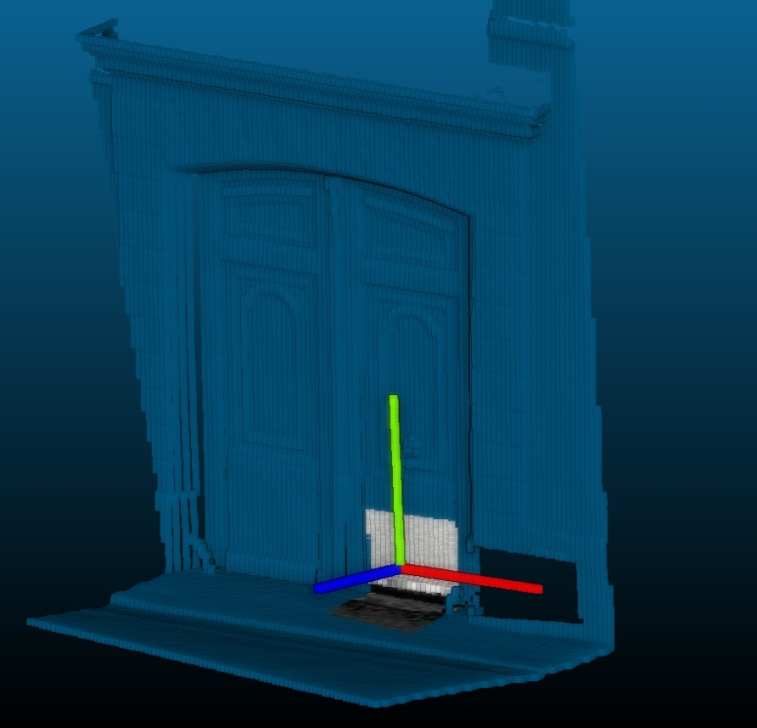
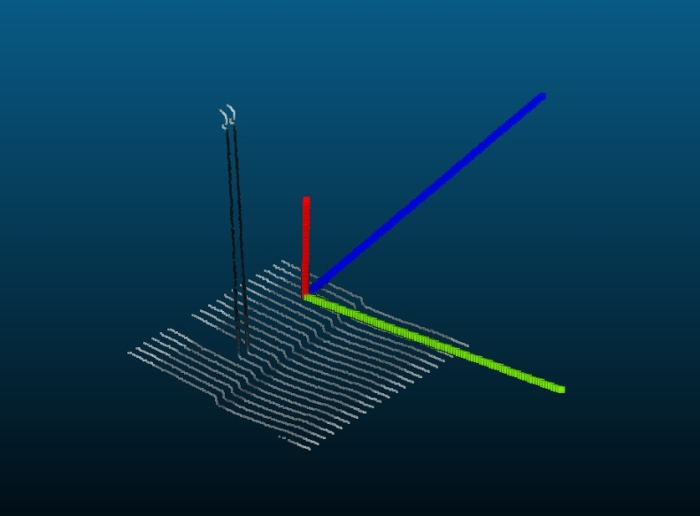
efficient storing/querying/Loading in postgres
BONUS :
FAST Function query : index on ND Descriptor
Define a function computing ND descriptors of the patch
example : How vertical is the patch? (based on ICA)
Create an index on it
(0.1 ,0.002,0.008)
(0.7 ,0.001,0.005)

Slide 24
efficient storing/querying/Loading in postgres
FAST Loading in PointCloud
Simple test : use PDAL (GDAL for point clouds wannabe)
Example of fast loading: project PointCloud_in_db (PROTOTYPE)
Parallel loading into a server : we can load as fast as we acquire data !
Prototype. Bash + sql
Patch table:
Id, PC_Patch(n)
Binary Point cloud files
(ply)
Linux Pipe
Temp table
X,Y,Z,I,…
Create patch
(GROUP BY )
Space + time
Write patch
Indexes
Convert to ASCII CSV
Psql+ COPY

Slide 25
efficient storing/querying/Loading in postgres
Order of magnitude
NOTA : put some sexy Zforest illustration
Tested on
T: terrestrial , 600 Millions, 22 Attributes . 12km of streets in Paris
2.1 Million rows
Table : 1.4 GByte | Toast : 29 Gbyte | indexes : 500 MBytes
Big variation in Density/patch
A : aerial, 5.2 Billions , 9 Attributes. 1300 km2 in Vosges, France
580k rows
Table : 64MByte | Toast : 45 Mbyte | indexes : 85 MBytes
Density almost constant.
Querying is fast! (1-2ms)
ASCII output : 100k pts/sec

Slide 26
In base processing
In Base processing : what is so cool about postgres?
PL/R : clustering
Pl/pgsql : patch->raster
PL/PYTHON : clustering
PL/Python :image processing : detection

Slide 27
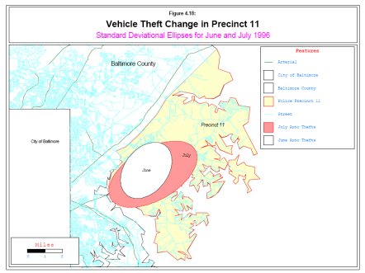
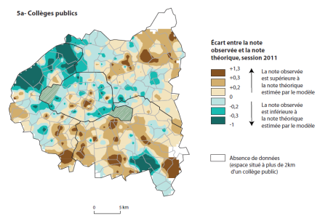
In base processing
In Base processing : what is so cool about postgres?
Very easy and fast for prototyping :
C , C++
High level languages :
R
Very advanced stats
Advanced Fitting/patterns/clustering capabilities
Many geo modules (sp …)
Possibility of GUI in browser (shiny)
Python
Powerful script language
Powerful Object Oriented language
Fully integrated in most GIS (ArcGIS, GRASS, QGIS))
Can link to C/Cpp for perf (Cython)
Java
Less integrated in postgres
Illustrations from [4]
Easy to learn/use
IO to DBMS + GIS world.
Central Repo
Fully portable
Well established

Slide 28
In base processing
In Base processing : what is so cool about postgres?
Easy to create an extension
High level languages
C , C++
Very efficient (memory/CPU)
Integrating into Postgres forces common meta API/data
This allows re-use / complex processing pipeline.
C world
SQL world
C++
/ C
lib
C API
Postgres
C
wrapper
Postgres
plpgsql
wrapper
SQL query

Slide 29
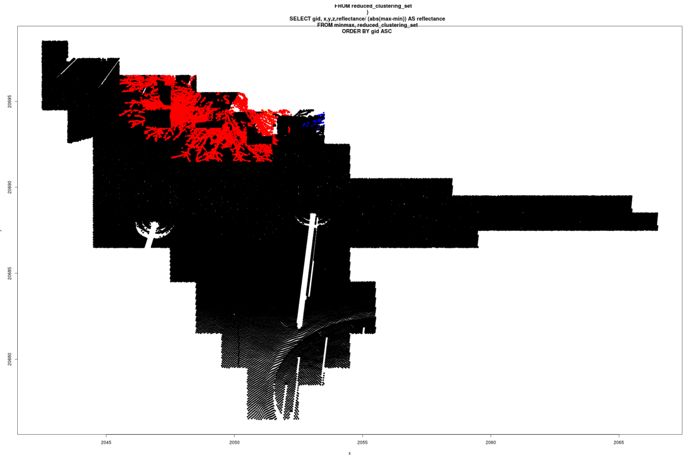
In base processing
PL/R clustering (proof of concept)
Unsupervised clustering.
Input = 3D points, module= nnclust , method = minimum spanning tree
Result : points in tree are separated from points on road

Slide 30
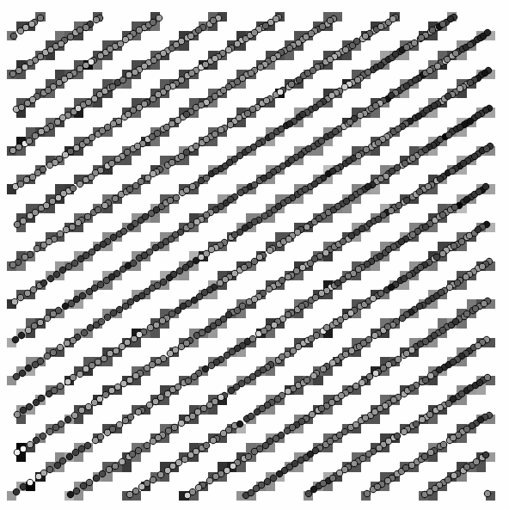
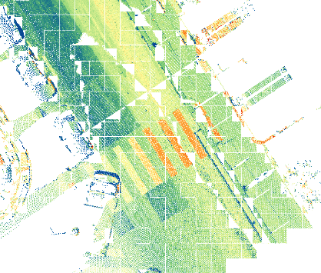
In base processing
pL/PGSQL Patch->raster (proof of concept)
For a patch
Get Bbox
Round X Y to pixel size
Group by X,Y rounded
For each attributes
Add a band
File the band with Mean/max/min of attribute
For computed pixels
Very slow (0.1 yo 1 sec/patch !)
Concept : raster+points. Color = reflectance. Qgis
A street part viewed in QGIS trough GDAL PostGIS raster driver

Slide 31
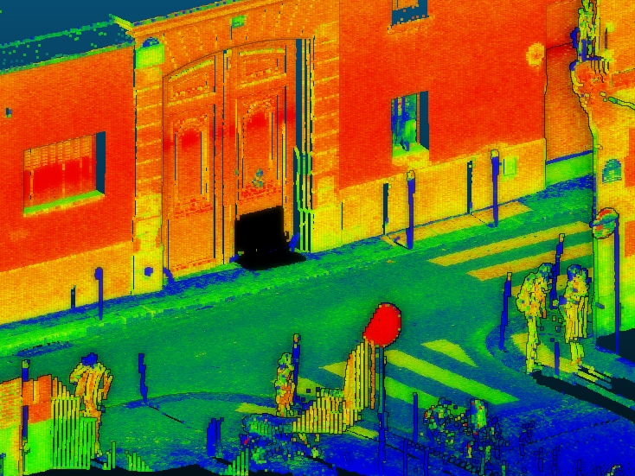
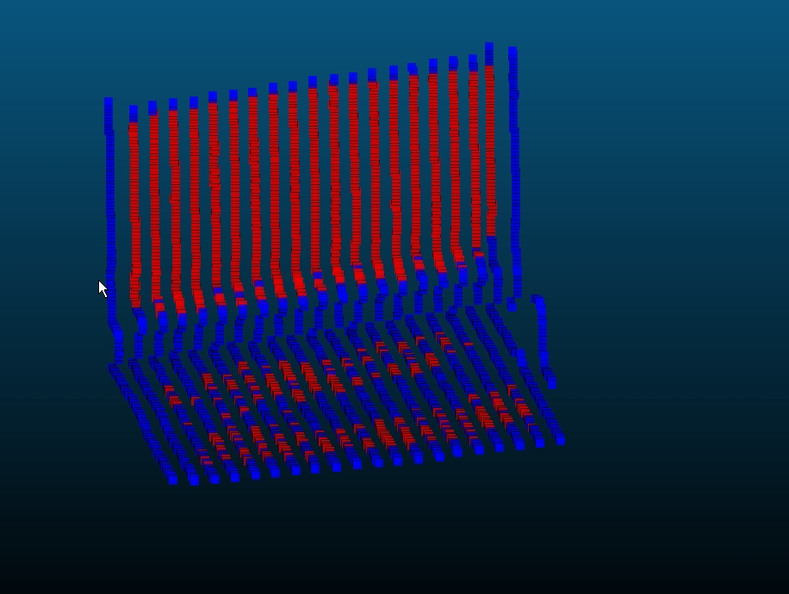
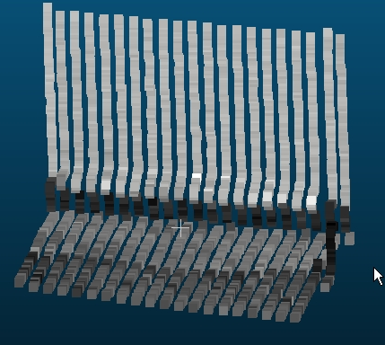
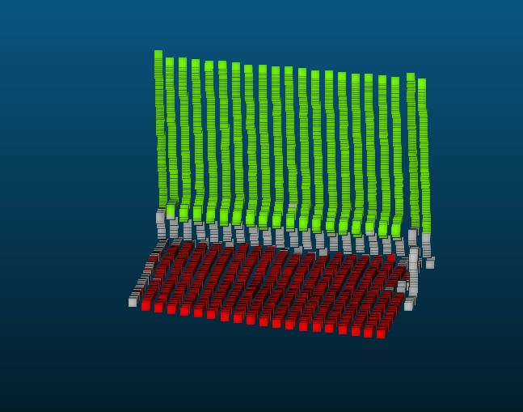
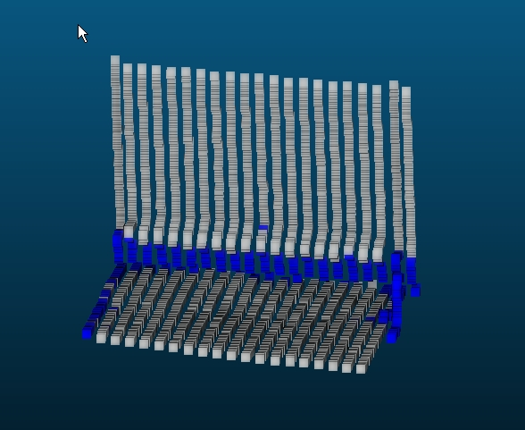
In base processing
PL/PYTHON unsupervised CLUSTERING (PROOF OF CONCEPT)
For list of points + reflectance (double[ ])
Convert list to numpy array
(Compute normals using python-pcl)
Cluster using sklearn.cluster.DBSCAN
Join clustering label to point id
context
3D + reflectance
labels
outliers
core

Slide 32
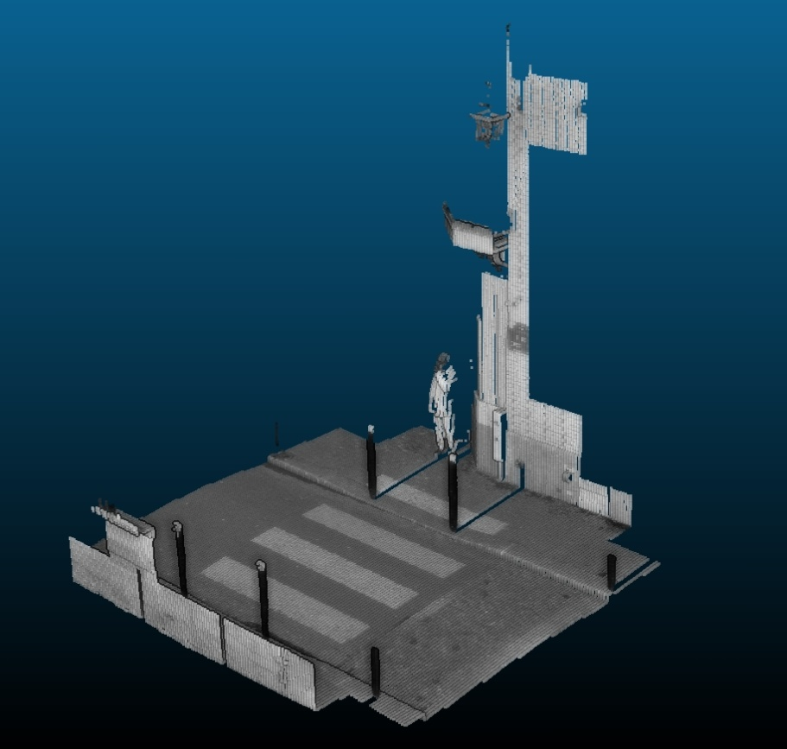
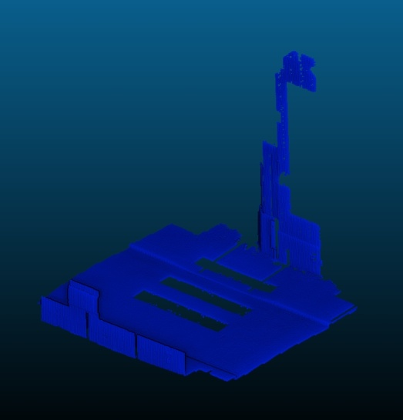
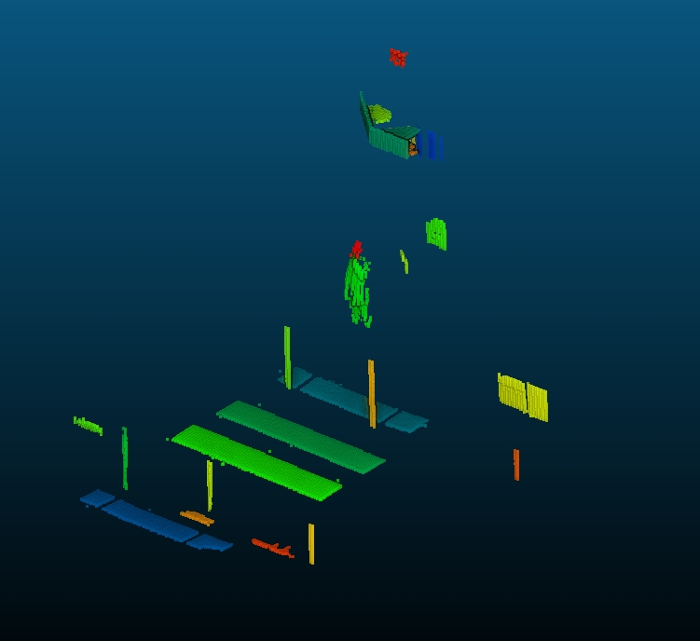
In base processing

Slide 33
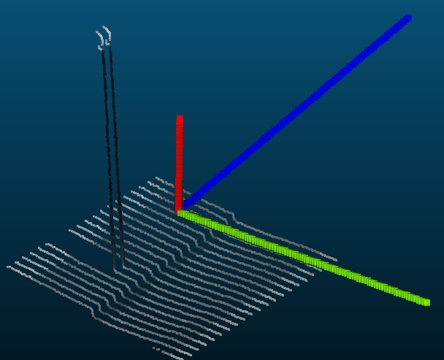
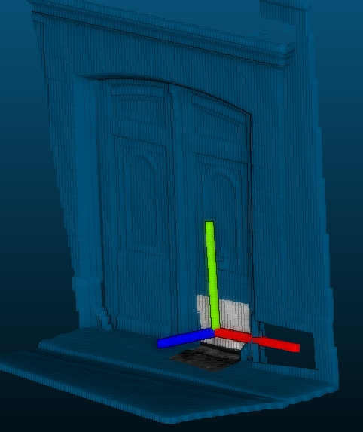
In base processing
PL/PYTHON descriptor (PROOF OF CONCEPT)
For list of points (double[ ])
Convert list to numpy array
Get Principal direction using sklearn.decomposition.FastICA
(Project result on Z)
Output measure
Idea : descriptor at patch level of verticality : is this patch façade/road/ tree/ mixed? => allow filtering at patch level

Slide 34
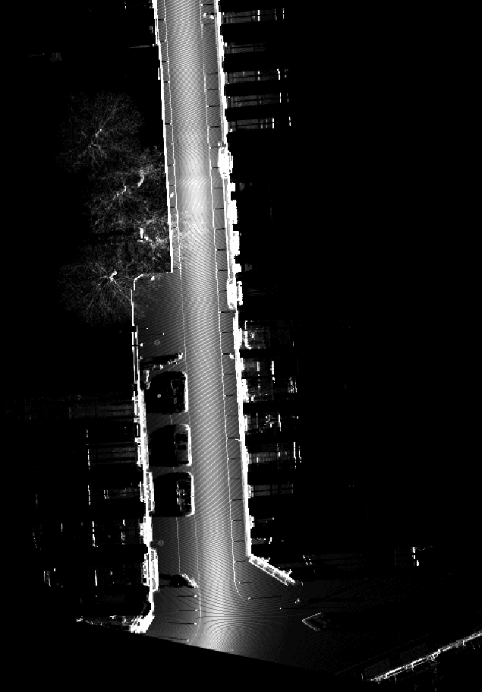
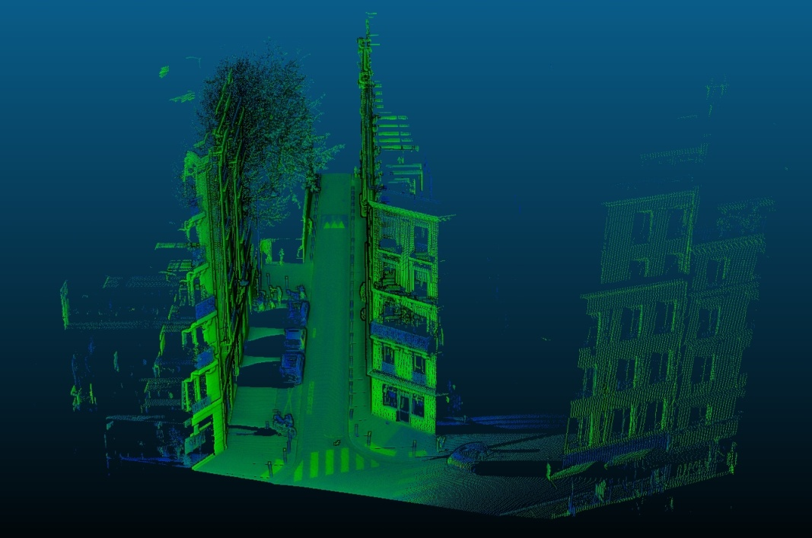
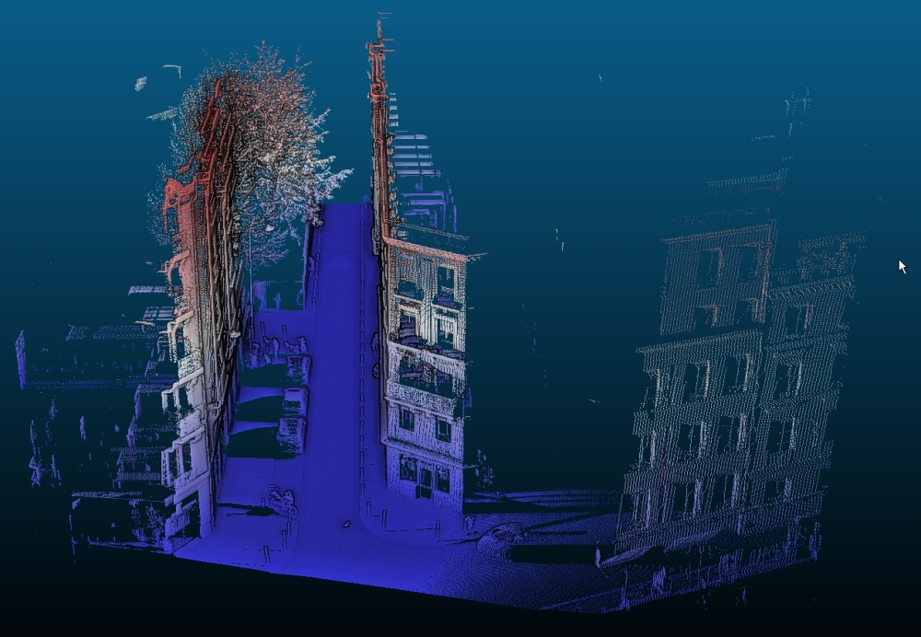
In base processing
PL/PYTHON image processing (PROOF OF CONCEPT)
Convert set of patches to raster (projection on Z of the points, rasterization)
Accum. raster. Lot’s of “NoData”
reflectance
Relativ height

Slide 35
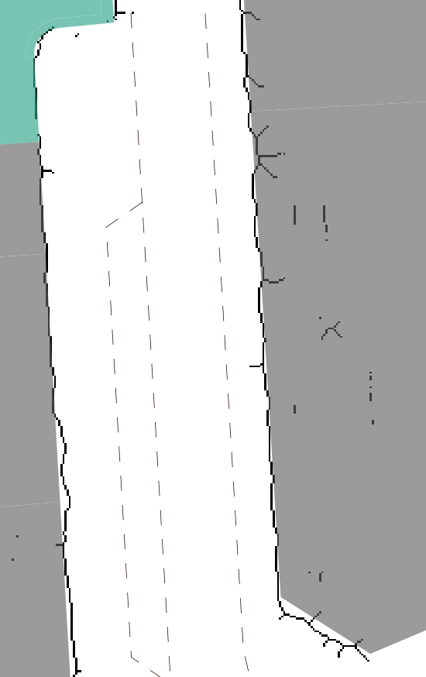
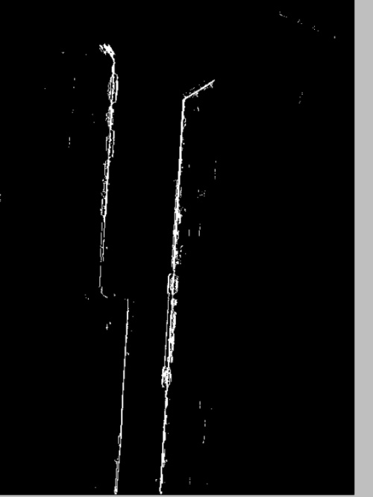
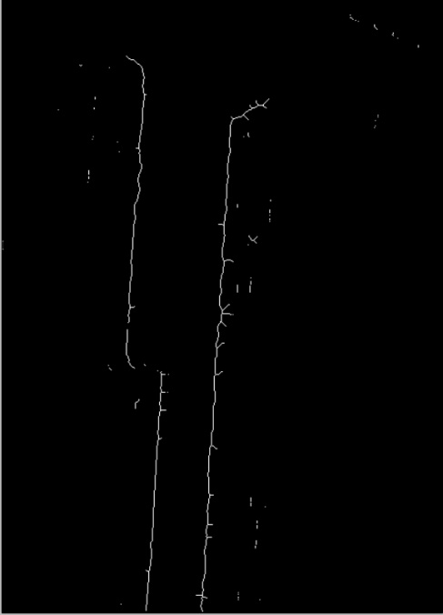
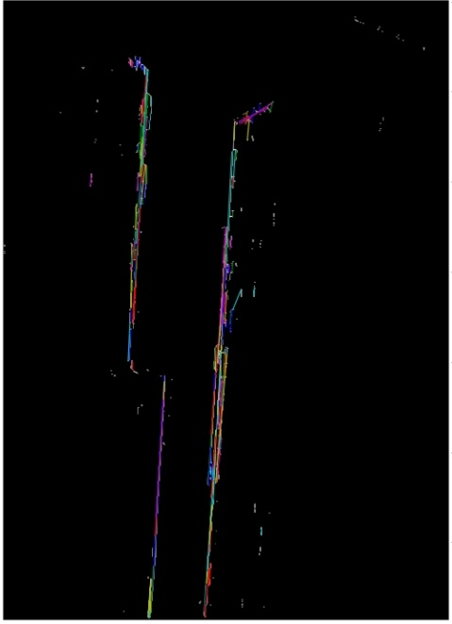
In base processing
PL/PYTHON façade detection (PROOF OF CONCEPT)
For a raster (accum) from a point cloud projected
Keep pixel high enough (higher than acquisition vehicle)
Remove pixel close to no data
Threshold on number of accumulated point per pixel
Morphological closing
Straight skeleton
Hough lines detection
Result with ground truth

Slide 36
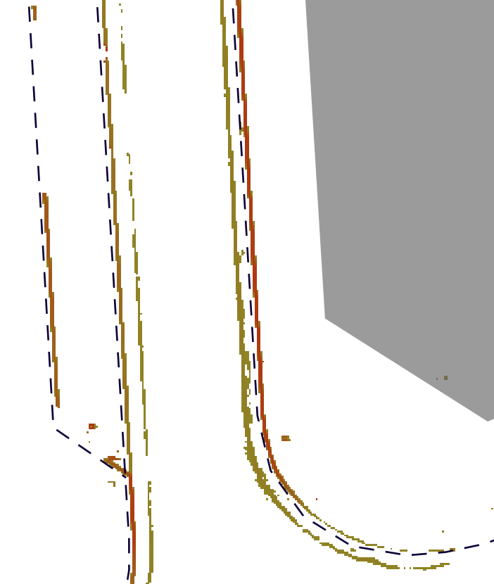
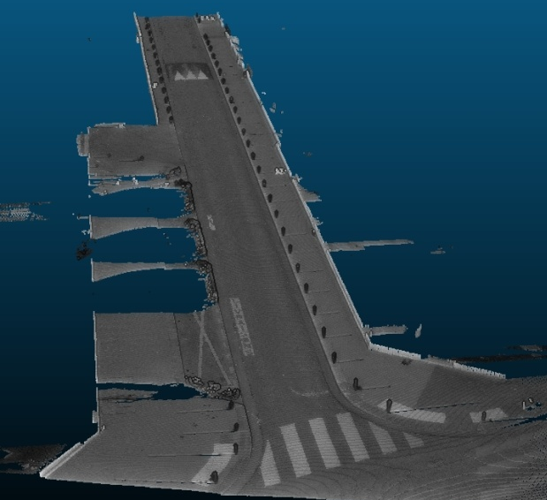
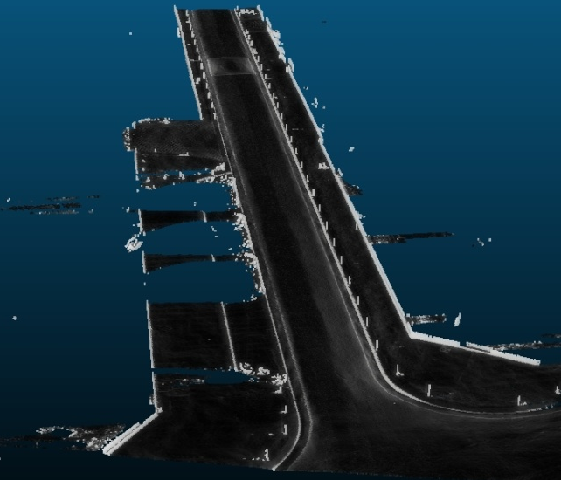
In base processing
PL/PYTHON Sidewalk detection (PROOF OF CONCEPT)
For a raster (height) from a point cloud projected
Keep pixel low enough (at vehicle wheels)
Remove pixel close to no data
Compute gradient of height (height variation)
Filter gradient to keep sidewalk (0.1 to 15 cm)
Result (orange to red) with ground truth (blue)
Reflectance at wheel level
Gradient at wheel level

Slide 37
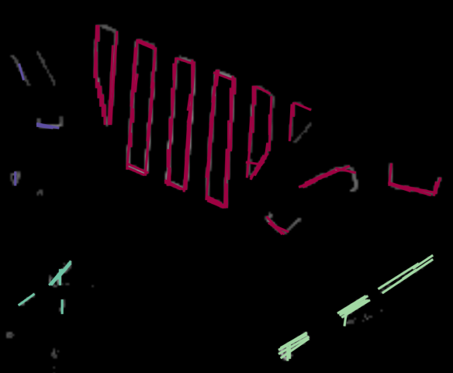
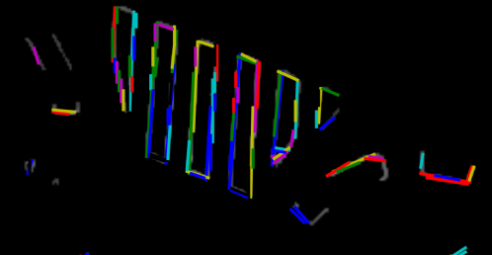
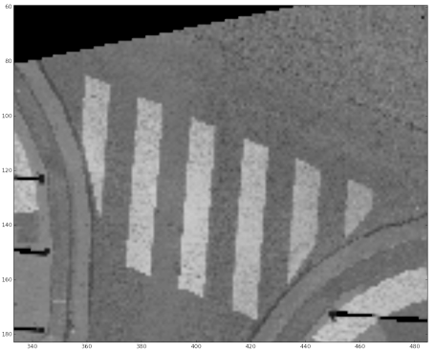
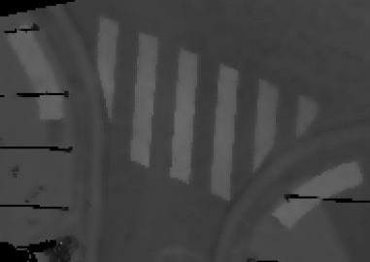
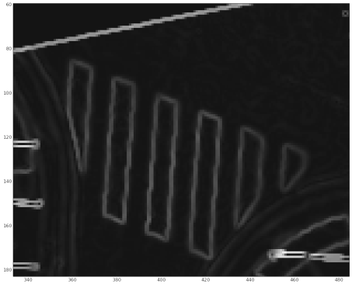
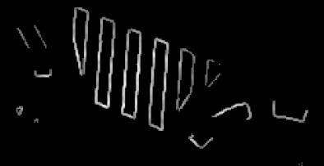
In base processing
PL/PYTHON Markings detection (PROOF OF CONCEPT)
For a raster (reflectance,height) of a point cloud projected
Compute height gradient
Remove pixels near NoData and/or non flat
Smooth reflectance while preserving edges (bilateral filter)
Compute reflectance gradient, threshold
Detect lines (Probabilistic Hough )
Compute center and angle of lines
Cluster lines using DBSCAN
Line clustering
Line detection
Raster reflectance
smoothing
gradient
threshold

Slide 38
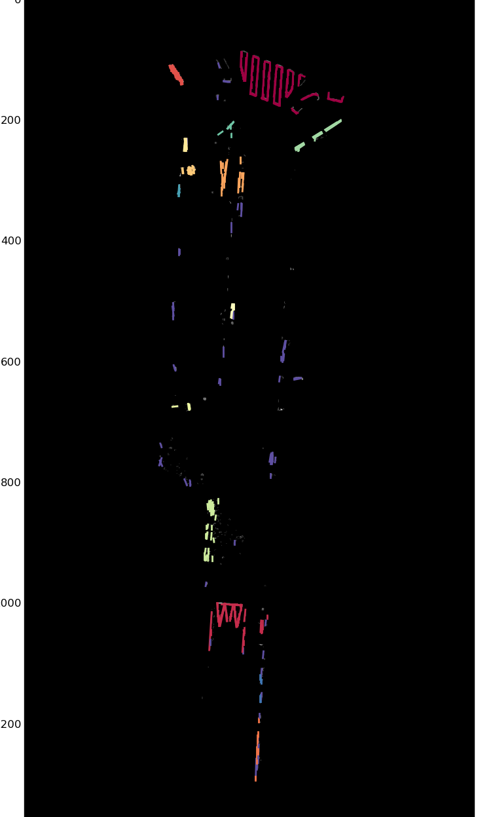
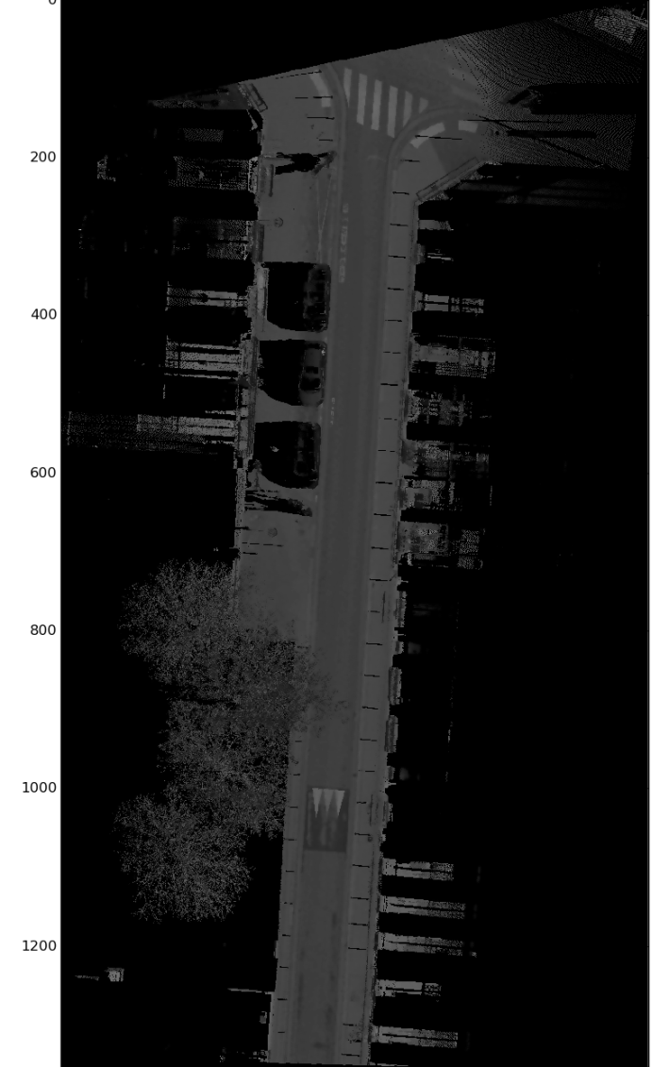
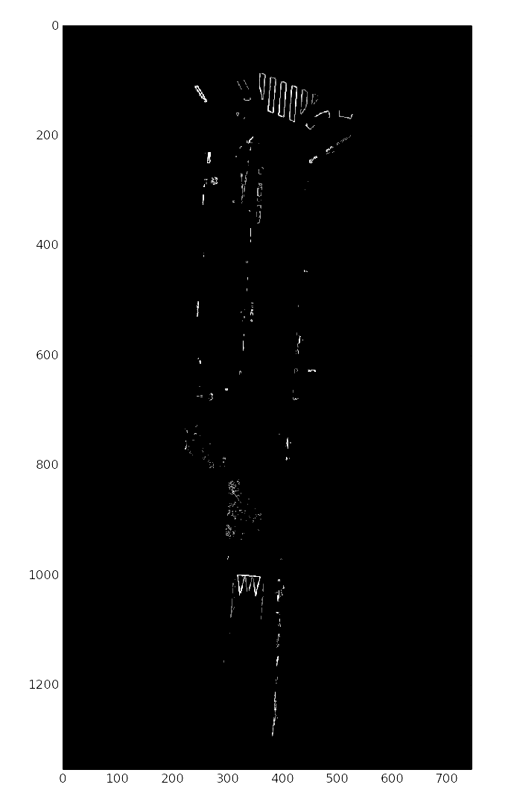
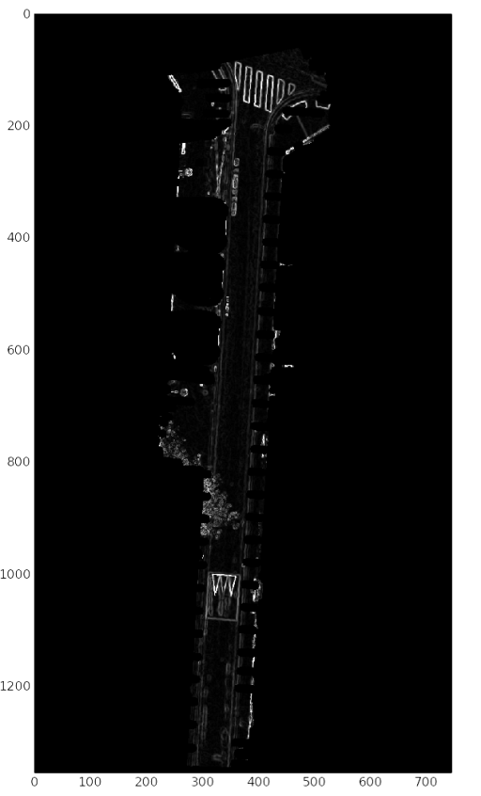
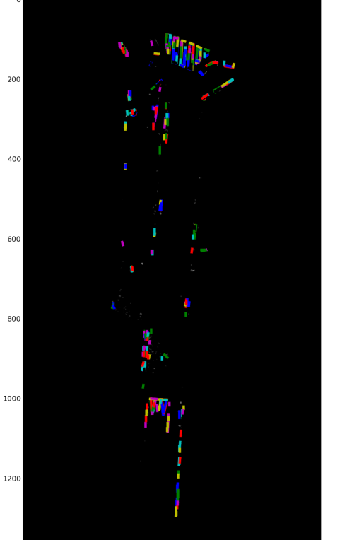

In base processing
PL/PYTHON Markings detection (PROOF OF CONCEPT)
Line clustering
threshold
Raster reflectance
gradient
Line detection
mask

Slide 39
using the point cloud server in complex architectures
Batch processing
Visualization : Level Of Detail
Visualization : point cloud streaming
Point cloud as a service

Slide 40


using the point cloud server in complex architectures
Batch processing:
How to launch (parallel) processing on overlapping areas?
Using file system : manual buffer. Need to load lot’s of files (x8 )
Crude grid pattern. Custom for every use case.
Difficult to use trajectory
One file processing
Foolowing file processing

Slide 41
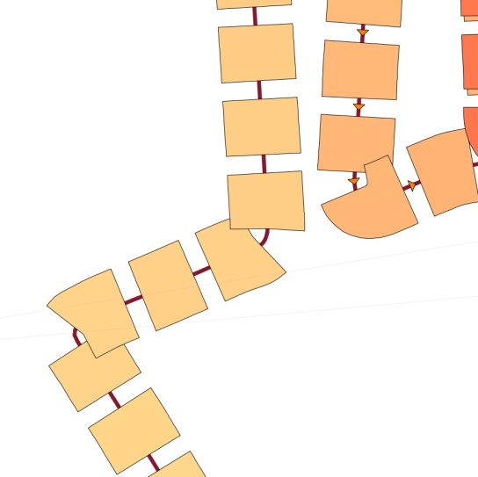
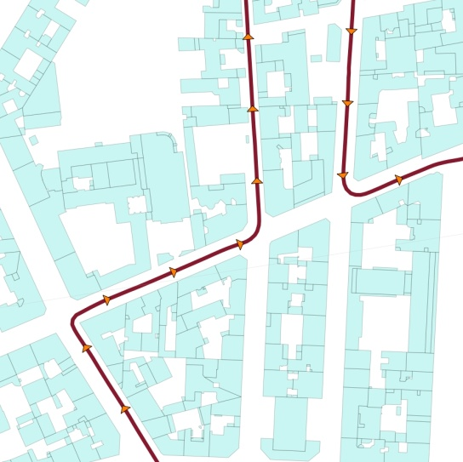
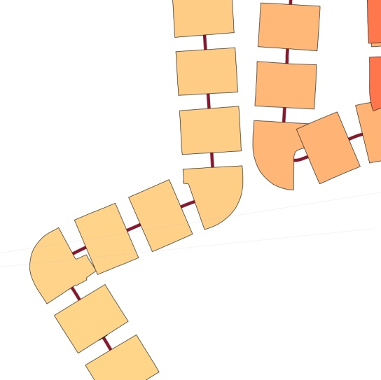

using the point cloud server in complex architectures
Overlapping surfaces 1
Batch processing:
Using point cloud server , but process see files
Exact control of overlapping/surfacesHere ( x1.5 )
Clean Loop management
Trajectory + buildings
Overlapping surfaces 2
Point cloud server
Use trajectory to generate overlapping surfaces
Trajectory data
patch
Temp point cloud for an area
Out of db processing

Slide 42

using the point cloud server in complex architectures
Visualization : Level Of Detail
no need for all the points all the time!
Max 1 point per pixel : 2 Millions for Full HD (+ cache + anticipating) If the patch is far away, need only few points
We need a way to generate pyramidal resolution for a patch!
D. Vandergucht, IGN, 2014

Slide 43
ressources
Documentation
tools

Slide 44
Doc
[1] J. Demantké: thesis
[2] P. Ramsey presentation of PointCloud : boundlessgeo.com/wp-content/uploads/2013/10/pgpointcloud-foss4-2013.pdf
[3] : Point cloud data management P. van Oosterom, S. Ravada, M. Horhammer, O. Marinez Rubi, M. Ivanova, M. Kodde and T. Tijssen IQmulus Workshop on Processing Large Geospatial Data, 8 July 2014, Cardiff, Wales, UK
[4] R: a free software for statistical analysis Introduction to the analysis of geographical data with R; 2014 ; R. Cura, H. Mathian

Slide 45
TOOLS
POINTCLOUD
CLoudCompare
RPLY
QGIS

Slide 46
Annexes
Sensor view

Slide 47

ANNEXES
Sensor view
Image from [1]

Slide 50
Demo postgres
_introduction aux nuages de points & les problématiques de ce genre de données
_serveur de nuages de points :
_stockage en base de données avec PointCloud
_chargement rapide et parallèle
_indexations et performances
Visu :
_visu 2D dans QGIS
_visu 3D interactive dans ITowns
_utilisation (une base de 0.6 milliard et une base de 5.8 milliards de points)
_niveaux de détails (quadtree/octree)
_analyse basique ( PL/R )
Processing Pl/python
_conversion en raster & traitements image basiques en base.
_utilisation par un algo interactif de détection de bord de trottoir (+zoo project)
_perspectives

Slide 51
Demo postgres
LOD maison
Index et filtrage

Slide 52
Demo PLR
Analyse de correlation
Spline fitting
Clustering (espace eucl+reflectance)

Slide 53
Demo python
Icp
filtrage
Detection de plan

Slide 54
Comparaison plpythonu/plr avec le package « fastcluster»

Slide 55
vtk Icp
http://www.vtk.org/Wiki/VTK/Examples/Python/IterativeClosestPoints

Slide 56
PCL : Detection de plans filtrage
https://github.com/strawlab/python-pcl/blob/master/tests/test.py
https://github.com/strawlab/python-pcl/

Slide 57
Conversion en raster
Cuisine perso + trick pour ecrire les fichiers rapidemment
Filtrage
Opencv
Image basique
Detection de cercle/lignes (hough)
Detecteurs
Matching pour trouver les marquages « velos »
http://docs.opencv.org/trunk/doc/py_tutorials/py_feature2d/py_feature_homography/py_feature_homography.html#py-feature-homography

Slide 58
Traitement d’image basique
http://docs.opencv.org/trunk/doc/py_tutorials/py_tutorials.html
Gradient + Detection de cercle avec OpenCV

Slide 59
avancé

Slide 60
24/06
Travail sur clustering dans R

Slide 61
Loading data
Use the github project PointCloud_In_DB
Get the data from IGN pointcloud benchmark
Follow instruction of github project
Install IGN spatial ref using the github project

Slide 62
Patch To Raster
Get the function from PPPP utilities
Get rc_random_string
rc_unnest_with_ordinality
Array_agg_custom (array of array)
Pour ecrire les raster qqpart :
write_file_texte
Activer les sorties pour les rasters :

Slide 63
Patch To Raster
Get the function from PPPP utilities
Get rc_random_string
rc_unnest_with_ordinality
Array_agg_custom (array of array)

Slide 64
Image processing : building detection
Need raster with pointcloud flattened, max height, pixel size = 10cm, + count of point/ pixel
Use python script
Import tif
Keep only pixel that are above the laser
Keep only pixel that have more than 100 pts/pixel
Export tif
Use sfcgal to consolidate lines
Execute sfcgal.sql to enable the sfcgal functions.
Execute code : 120 sec, complex sql
Use python to consolidate lines
1 sec , very few lines.

Slide 65
Image processing : sidewalk detection
Need raster with pointcloud flattened, min height, pixel size = 5cm, + count of point/ pixel
Use python script
Import tif
Keep only pixel that are between -3 and -2 meters (relativ to laser (ground = -2.5meter))
Compute sobel filtering on Z ,using mask found before (nota : gives the local height variation)
Keep values between 1cm and 12 cm (official possible height)
Export tif

Slide 66
Pointcloud processing : from patch to python numpy array
Get function array_of_array from PPPP_utilities
Get function from PPPP/pointcloud : rc_explode
Using pointcloud to perform plan and cylinder detection : env 1sec/patchde 4k points
Using sclearn to perfomr ICA : same
Using sclearn to perform dbscan : 4sec + using point cloud for normal computation + using pointcloud for outliers removal

